Slide 1
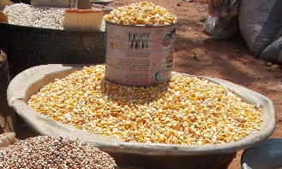
Maize Yield Response to Fertilizer under
Differing Agro-Ecological Conditions in Burkina Faso
Veronique Theriault, Melinda Smale, and Hamza Haider, MSU
Agricultural & Applied Economics Association Annual Meeting, Chicago, Illinois, July 30-August 1, 2017
Notes:
I am presenting this research on behalf of my co-authors from Michigan State University.

Slide 2
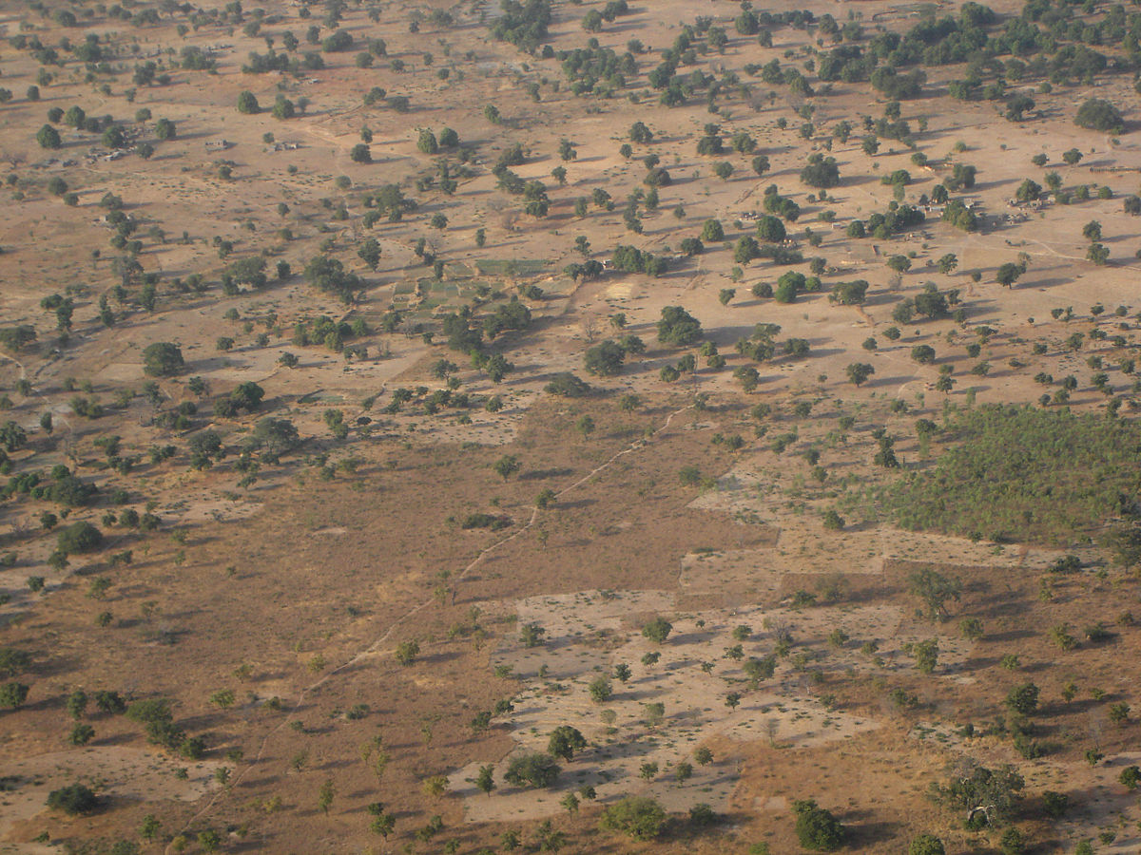
Motivation
Achieving food security depends on smallholder productivity
Intensification the only option:
  High population density
  Aged, degraded soils need mineral fertilizer
Fertilizer policy: “blanket recommendations”
Diverse agro-ecologies → variable economic incentives
Notes:
Achieving food security in Sub-Saharan Africa depends on raising the productivity of smallholder farmers—the cornerstone of most agricultural economies in that region.
To enhance crop productivity in Burkina Faso, there is no option other than intensification.
The soils in the Sahel and Savanna of West Africa are old, deep and poor in soil organic matter, with low capacity to retain nutrients, while this region is also the most densely populated in the continent. These soils need mineral fertilizer.
Yet, as in other countries of SSA, national agricultural research systems in Burkina Faso formulated fertilizer recommendations during the 1970s and 1980s, but these did not, and still do not, take differing agroecologies into account.
The heterogeneity of overall agro-ecological and soil conditions at regional, national, and local scales has led to diversity of farming systems, cropping patterns, soil management considerations, and input markets. This diversity is likely to lead to highly variable economic incentives for smallholder farmers.

Slide 3
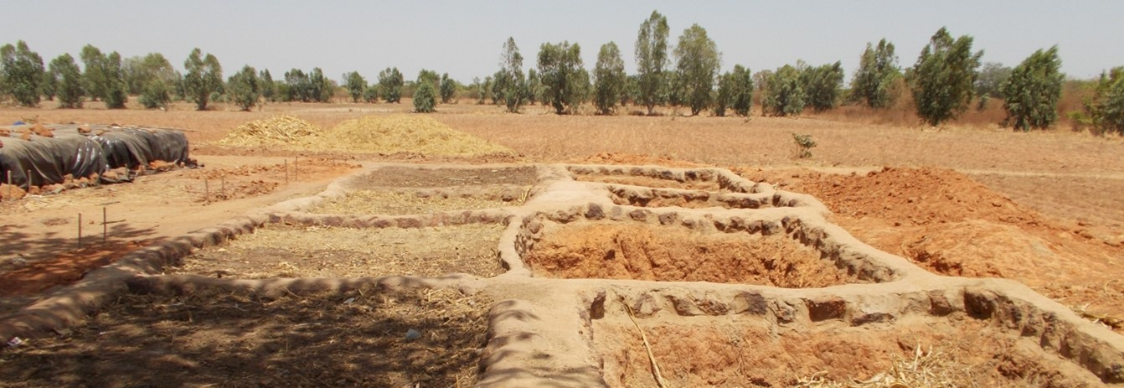
Research hypothesis
Response of maize yields to fertilizer and profitability of fertilizer use on maize varies by agro-ecological factors
Contribution to a sparse regional literature
Notes:
Our analysis contributes to a sparse regional literature on maize yield response to fertilizer that is estimated with data collected from farm households. In recent years, most similar analyses have been conducted in Eastern and Southern African countries (e.g. Marenya and Barrett 2009; Xu et al. 2009; Sheahan, Black, and Jayne 2013). Farming context and agro-ecological conditions are vastly different in the West African Sahel. Studies by Koussoube and Nauges (2017) in Burkina Faso and Foltz, Aldama, and Laris (2012) in Mali represent exceptions, but neither of these controlled for variations over both time and space. Decades ago, Henao et al. (1992), Kouka, Jolly, and Henao (1995) and others analyzed agronomic optima using trial data from northern Ghana and Mali. A recent compendium summarizes agronomic research on fertilizer optimization across the continent, including Burkina Faso (Wortmann and Sones 2017).

Slide 4
Context
3 agro-ecological zones
  Sahelian (< 600 mm)
  Sudano-sahelian (600-900)
  Sudanian (900-1200)
10 soil types
  2/3 of the country is covered by soils that are iron-rich and low in organic matter
Maize area ↑ by 700% in 40 years
Notes:
Officially, agro-ecological zones in Burkina Faso are constructed solely on the basis of rainfall isohyet, consisting of Sahelian, Sudano-Sahelian and Sudanian zones (Bainville 2016; De Longueville et al. 2016). Maize: Sudano-Sahelian and Sudanian zones. Across the entire country, the rainy season lasts from three to six months, with the longest season in the Sudanian zone, and the shortest one in the Sahelian zone.

Slide 5

Data
Continuous farm household survey from the General Research and Sectoral Statistics Department (DGESS), 2009/10-2011/12
  2,321 households (out of 2,700) and 9,526 maize plots
National Oceanic and Atmospheric Administration’s Climate Prediction Center
European Union’s Soil Atlas of Africa
Notes:
We test our hypotheses by estimating a maize yield response function at the plot level with data collected during three cropping seasons (2009/10, 2010/11 and 2011/12) under the Continuous Farm Household Survey (Enquête Permanente Agricole (EPA)
After dropping households that were not continuously surveyed over the three-year period and those that did not cultivate maize, we have 2,321 households (out of 2,700) and 9,526 maize plots.
To construct more nuanced indicators of agro-ecological zones than rainfall isohyets, we linked GPS coordinates for the village of each surveyed household to rainfall data from the National Oceanic and Atmospheric Administration’s Climate Prediction Center and to soils information from the European Union’s Soil Atlas of Africa. Each survey village was assigned to an official agro-ecological zone based on its average rainfall history over the last decade. All but 1% of all maize plots are located in the Sudano-Sahelian and Sudanian (above 900mm isohyet) zones.
The annual rainfall and coefficients of variation in total annual rainfall at the village level over the last three years were also computed.
We used the GPS coordinates to identify the different soil types in our sample and classify them, based on their suitability for maize production, into three groups: 1) excellent ; 2) good ; 3) poor and marginal soils
72% in marginal; 12% in good and 16% in excellent.

Slide 6
Methods
Yield response function
Profitability
Control function approach with correlated random effects
Quadratic term for N
Interaction of N with agro-ecological factors
Agro-ecological factors measured at several scales
Marginal product of N
Marginal value-cost ratio (MVCR)
Average value-cost ratio (AVCR)
Low, average, and high farm gate prices
Market, official subsidized, and transacted-subsidized fertilizer prices
Notes:
We test and control for endogeneity of fertilizer with a Control Function Approach (CFA), employing Correlated Random Effects (CRE) to address time-invariant unobserved effects that may be related to household decision-making.
There is a lot in the lit about functional form, but more flexible forms with large numbers of covariates in hh survey data (not just inputs, but manager and hh characteristics) are intractable. We have the interactions with key variables only, and a quadratic term for N.
Agro-ecological conditions are indicated by a range of covariates, including climatic zone, soil quality, and plot characteristics such as presence of trees, fallow, soil and water conservation structures, location and slope.
We then examine the profitability of fertilizer use by calculating the marginal and average value-cost ratios based on the estimated coefficients.

Slide 7
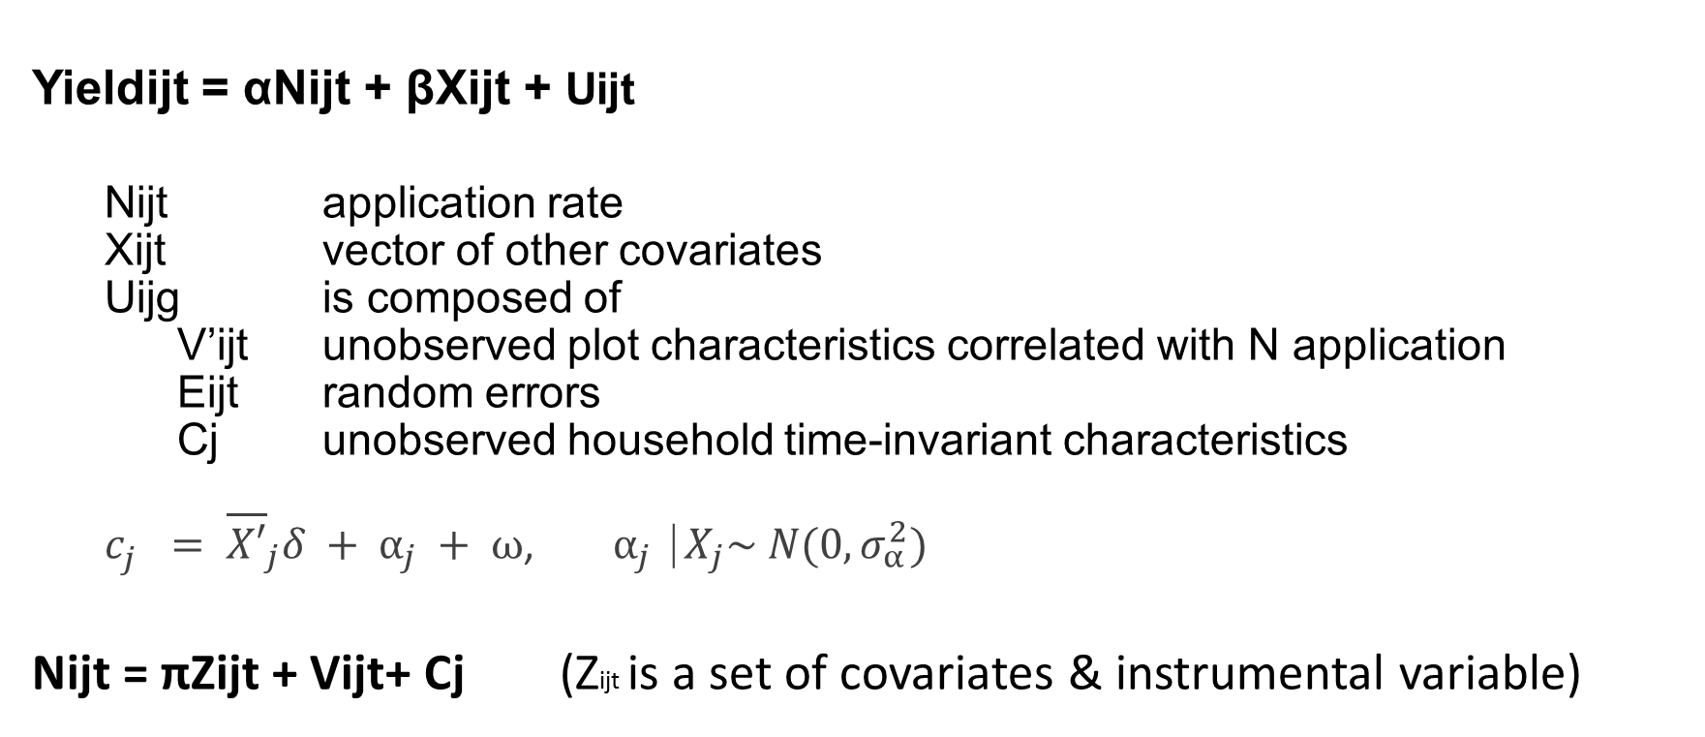
Yield Response
Yieldijt = αNijt + βXijt + Uijt
  Nijt application rate
  Xijt vector of other covariates
  Uijg is composed of
  V’ijt unobserved plot characteristics correlated with N application
  Eijt random errors
  Cj unobserved household time-invariant characteristics
  $c_{j}^{}= {\overline{X′}}_{j}δ + α_{j} + ω$, $α_{j}⎹ X_{j}\sim N(0, σ_{α}^{2})$
Nijt = πZijt + Vijt+ Cj (Zijt is a set of covariates & instrumental variable)
Notes:
Yield response function on plot i, household j, time t. where N_{ijt} is the nitrogen application rate and X_{ijt} represents a vector of other covariates. The error term U_{ijt} is composed of three parts: V_{ijt ,} E_{ijt ,} C_{ij} . E_{ijt} are random errors, V_{ijt} are unobserved characteristics that are correlated with nitrogen application, and C_{ij} are unobservable time-invariant characteristics.
We expect fertilizer application to be correlated with unobserved characteristics, such as plot manager’s skills and agronomic conditions. To address this, we include plot manager characteristics, agro-ecology, soil, rainfall factors at various scales.
We test and control for potential endogeneity by employing an instrumental variable technique. To be valid, the instrument must be sufficiently correlated with fertilizer application (inclusion restriction) and uncorrelated with the error term (exclusion restriction). After testing several of the instruments used in previous research on the topic, our strongest is the proportion of households in the commune that belong to cotton cooperatives. Since commercial fertilizer markets are still underdeveloped in Burkina Faso, cotton cooperatives remain the primary source to access fertilizer, but membership is not correlated with soil characteristics. Note that the instrument excludes the village where the household lives.
We use the CFA instead of 2SLS to handle the potential endogeneity resulting from interaction terms
The Mundlak-Chamberlain device addresses time-invariant hh heterogeneity by including the means of observed covariates (the projection of c on X).
All SE bootstrapped to control for second stage estimation with predicted residuals V-hat

Slide 8
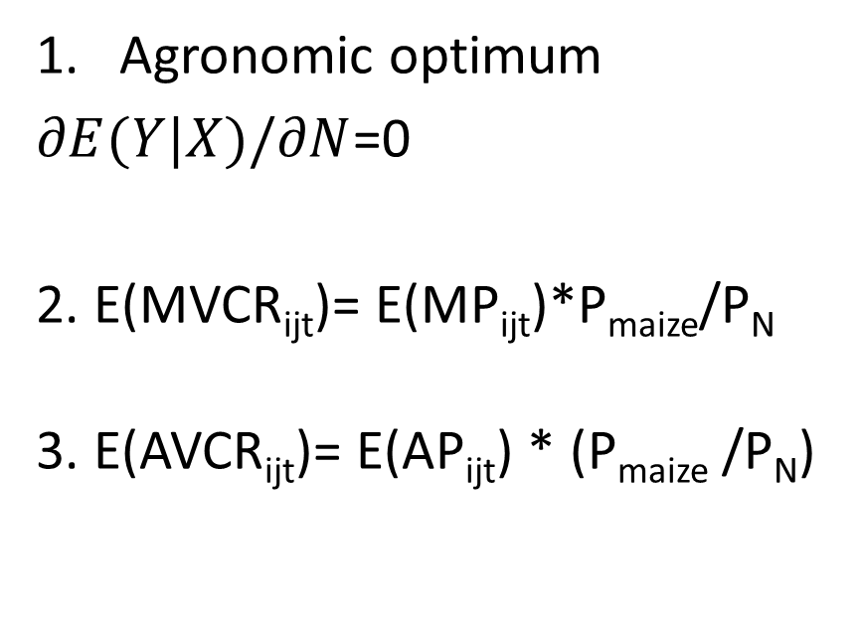
Profitability
Parameters
Sensitivity
Agronomic optimum
$∂E(Y|X)/∂N$=0
2. E(MVCR_{ijt})= E(MP_{ijt})*P_{maize}/P_{N}
3. E(AVCR_{ijt})= E(AP_{ijt}) * (P_{maize} /P_{N})
Average low, mean, and high farmgate price for maize
Fertilizer prices
  Market
  Official, subsidized (50% of P_{f})
  Transacted, subsidized
    23% of urea price
    28% of NPK price
Notes:
To examine the profitability of fertilizer use, we first obtain the marginal product of N by taking the partial derivative of expected yields conditional on X with respect to N in the regression equation. To find the optimal quantity of nitrogen to apply from an agronomic view point, we set the derivative equal to zero and solve for "N".
Next, we examine the marginal value/cost ratio (MVCR), which is the value of an increase in maize output that results from applying an additional kilogram of nitrogen divided by the price of one kilogram of nitrogen. The general rule is that profit is maximized by applying the quantity of nitrogen at which marginal revenues equal marginal costs, or MVCR equals one.
We compute MVCRs under various fertilizer costs and farm gate prices for maize. An average low, mean, and high price value for maize is computed using monthly farm gate prices across the three crop years (INERA 2013).
We also consider three different fertilizer costs: market price, official subsidized price, and transacted subsidized price. The subsidized fertilizer prices for urea and NPK are set at 270 FCFA/kg and 250 FCFA/kg, which is 50% below market prices (MAFAP 2013). High transaction costs, due in part to poor road infrastructure and illicit tax collection, reduce the effective subsidy by 28% and 23% of the market price for urea and NPK compared to the official 50% price reduction (Holtzman et al. 2011).
The profitability incentive to use fertilizer has been examined frequently with the average value cost ratio (AVCR). The AVCR is calculated as E(AVCR_{ijt})= E(AP_{ijt}) * (P_{maize} /P_{N}), or the expected quantity of maize produced per unit of nitrogen, holding all other productive inputs fixed, times the maize-nitrogen price ratio. The average product of N is obtained by dividing the expected yield by N. Profitability has been considered low if the AVCR is less than two (Morris et al. 2007). When production or price risk is high, an AVCR ratio of three to four has been considered necessary to ensure profitability (Kelly 2005). In countries such as Burkina Faso, where maize production is entirely rainfed, we propose a minimum AVCR of three.
Like Xu et al. (2009), we use the price of urea and NPK and their nutrient content to estimate the price of nitrogen per kilogram. The amount of each fertilizer required for 1 kg is given by 0.46X + 0.15x= 1. Solving for x, we get x=1.63. Therefore, 1 kg of nitrogen costs approximately 1.63 kg of each fertilizer, or P_{N}= 1.63 (P_{urea}+P_{NPK}).

Slide 9
Variables
Agroecological factors at three scales of analysis:
  Plot
    size (ha), location (in/outside of compound), and toposequence (lowland, plain, slope)
    Presence of soil or water conservation structures, agroforestry, intercropping, and fallow
  Village
    Total rainfall, coefficient of variation of rainfall (village)
    Excellent, good, or poor/marginal soils (village)
  Zone
    Sudano-sahelian or Sudanian zone
Other productive inputs, plot manager, plot management type and tenure, household characteristics
Notes:
Other productive inputs include seed, manure, herbicide, fungicide, pesticide, raticide, labor
Household characteristics inlcude size, TLUS owned, total landholding size, income

Slide 10
Estimated maize yield response functions
Variables | CRE | CFA-CRE
N | 2.91*** | 22.46***
N*N | -0.014*** | -0.016***
Intercropping | -235.24*** | -155.90***
SWC | 70.28** | 78.85**
Excellent soils | 16.26 | 52.52*
Good soils | 178.75*** | 239.20***
Sudanian zone | -198.46 | -65.62
N*excellent soils | -1.82** | -1.68**
N*good soils | -3.12*** | -2.09***
N*sudano-sahelien zone | 1.22*** | 1.44***
Controlling for other productive inputs, plot manager and household characteristics, household time-averages and crop years.
Notes:
Here we report only the results of main hypothesis tests:
As expected, the coefficient estimate of nitrogen application rate is positive and significant across the models, whereas its squared term is negative and significant, indicating that as nitrogen applicate rate increases, maize yield increases at a decreasing rate. However, the coefficients on N are very small in the models that assumes fertilizer use to be exogenous
The F-statistic of the first stage (F (6, 1846) = 34.28; Prob > F= 0.0000) indicates that the instrument, cotton cooperative membership, is strongly correlated with the potentially endogenous variable, nitrogen application rate (coefficient = 18.44***). The exclusion restriction is also highly plausible because the proportion of households belonging to a cotton cooperative at the commune level is unlikely to affect maize yields at the plot level in our econometric specification. The other diagnostic statistic that supports the endogeneity of fertilizer application is the high level of significance of the predicted residual of nitrogen applicate rate (p-value=0.000) in the second stage regression of the CFA-CRE models.
Various agro-ecological indicators measured at the scale of the plot are statistically significant across the models: toposequence, size, intercropping, presence of soil and water conservation structures positively affect maize yields.
Introducing agro-ecological factors at a scale larger than the plot, we see that yields are significantly higher on soils considered to be excellent and good for maize production, compared to poor and marginal soils. Interaction terms between nitrogen application and soil types are statistically significant. Compared to good and excellent soils, maize production on poor and marginal soils benefit the most from an additional kilogram of nitrogen.
No statistically significant yield differential is found between the Sudano-Sahelian and Sudanian zones, but the interaction term between nitrogen application and agro-ecological zone is statistically significant. Maize production in the Sudano-Sahelian zone benefits the most from an additional kilogram of nitrogen.
The estimated response rate in the full model is in line with other estimates for maize based on data from farmers’ fields in SSA and in Burkina Faso.

Slide 11
Average partial effect of N and optimum
 | Average partial effect of N-hat | Average partial effect of N- 95% CI | Unconditional N (kg/ha) | Conditional N (kg/ha) | Agronomic optimum N
Average | 22 | 13-31 | 16 | 38 | 722
Net loss of ~700 kg/ha of N over a 30 year period (World Bank, 1996)
Nutrient depletion can even reach 100 kg NPK/ha/year (Henao 1992)
Our results suggest a continuous soil fertility depletion in maize farming
Notes:
The average shown here is across all zones and soil types.
In Burkina Faso, agronomic research recommends 50 kg/ha of urea and between 150 and 200 kg/ha of NPK on maize, regardless of the agro-ecological conditions. The quantity of fertilizer N applied to plots (conditional on use) is the closest to recommendations in the Sudanian zone, but fell short nationwide. The gap is even more striking when we consider plots with no fertilizer applied.
On average, the agronomically optimal nitrogen application is 722 kg per hectare—a high value that is driven by the low nitrogen squared coefficient estimate (-0.02) in the yield response function. Using the nitrogen squared coefficient estimate from the 3SLS regression (-0.11), Kousoumbe and Nauges (2017), calculated that nitrogen application ranging from 77 to 106 kg/ha maximized yield. However, if they would have chosen the coefficient estimates on the squared terms from the 3SLS-FE (-0.03) or OLS (-0.05) regressions, their results would have had an order of magnitude similar to ours.
Earlier research in sub-Saharan Africa provides an interpretation. Stoorvogel et al found a net loss of about 700 kilogram of nitrogen per hectare over a 30-year period; other more recent findings reported in the book by Wortmann and Sones. Henao (1992) reported that nutrient depletion can reach 100 kg NPK/ha/ year in Burkina Faso and Mali. Our results suggest a continuous soil fertility depletion in the maize farming system. With a maximum value of 278 N g/ha, the turning point at which an additional kilogram of nitrogen no longer benefits the crop, lies outside the range of the data.

Slide 12
Value-cost ratios
Price Scenario | Fertilizer at market price MVCR AVCR |  | Subsidized fertilizer price MVCR AVCR |  | Subsidized + TC price MVCR AVCR
Low | 1.6 | 1.6 | 3.2 | 3.2 | 2.1 | 2.2
Average | 1.7 | 1.8 | 3.5 | 3.5 | 2.3 | 2.4
High | 1.9 | 2.0 | 3.9 | 3.9 | 2.6 | 2.6
Profit maximization at MVCR=1
Incentive if AVCR >2 (Morris et al. 2007); AVCR >3-4 (Kelly 2006)
Notes:
Here are the MVCRs and AVCRs under each scenario, using the expected marginal product (22.14 kg/ha) and expected average product (22.38 kg/ha), respectively. Given the nature of farming in Burkina Faso, where crops depend entirely on rainfall, there is uncertainty in regards to the outcome of fertilizer use. Plot managers apply fertilizer at lower rates than those that would maximize profit, as evidenced by the MVCRs above 1.
At full market prices, AVCRs are below 2, indicating that fertilizer use is unprofitable regardless of farm gate prices for maize. The ratios rise above 3 with an official price subsidy of 50%, despite low farm gate prices for maize. At the official subsidized price, incentives to use fertilizer are strong (above 2 but below 3), overcoming price and production risks. Transactions costs erode the apparent advantages of the subsidy, however.
The confidence intervals in the previous table exhibit wide variation in the average partial effect of nitrogen (from 13 kg/ha to 31 kg/ha). Even under suitable agro-ecological conditions for maize and fertilizer subsidies, it is not always profitable to use fertilizer on all maize plots. Further, the minimum average product for fertilizer use to be profitable (AVCR=2) lies in some instances outside the 95% confidence intervals (analysis available from the authors).

Slide 13
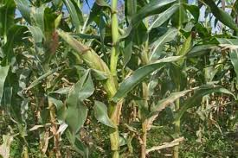
Conclusions
Maize yield response to N is ~ 22 kg/ha
Agro-ecological factors, at the scale of plot, village soil type and climatic zone, do affect maize yield response to fertilizer and productivity
Optimal N rates > maximum N application rates
Not always profitable to use fertilizer

Slide 14

Policy implications
Caution when generalizing across agroecologies
Does a crop targeted fertilizer subsidy program make sense?
Importance of reducing transaction costs
Location-specificity vs. scale
Notes:
For example, policy makers need to be cautious when generalizing across regions or drawing policy recommendations from a single agro-ecological zone because crop responses and economic incentives vary widely across agro-ecological conditions. Policies that take heterogeneity into account may be more effective in promoting sustainable input use by making it more profitable. As currently designed, the fertilizer subsidy program promotes maize, which is not well-suited to all agro-ecologies in Burkina Faso. Programs targeted to a single crop may not be desirable, especially in the context of climate change. Although the subsidy enhances profitability (to the extent that it covers transactions costs), there may be more effective ways to make fertilizer more affordable to farmers. For instance, investing in road infrastructure and removing illicit tax collection could lead to significant cut in transactions costs while freeing up resources from the agricultural budget to enable other services, such as research and development and extension.

Slide 15
Descriptives
40% of maize plots fertilized (all years)
Unconditional mean of N kg/ha=16
Conditional mean of N kg/ha=38
Mean yield w/out fert=970 kg/ha
Mean yield w/fert=1314 kg/ha
Recommended rate = 45.5-53 N/ha
zones
soils
Notes:
All distributions tend to be positively skewed, with a long right tail. Regardless of the agro-climatic zones and soil types, there is a small number of plots that are highly productive, with maize yields exceeding 2,000 kg/ha.
Our mean is 16 N kg/ha, including zeros. Those who apply it are much closer to recommended rates
In Burkina Faso, agronomic research recommends 50 kg/ha of urea and between 150 and 200 kg/ha of NPK on maize (Holtzman et al., 2013), regardless of the agro-ecological conditions (this varies only by crop and rainfall, so between 45.5 and 53 N kg/ha

